Slide 1

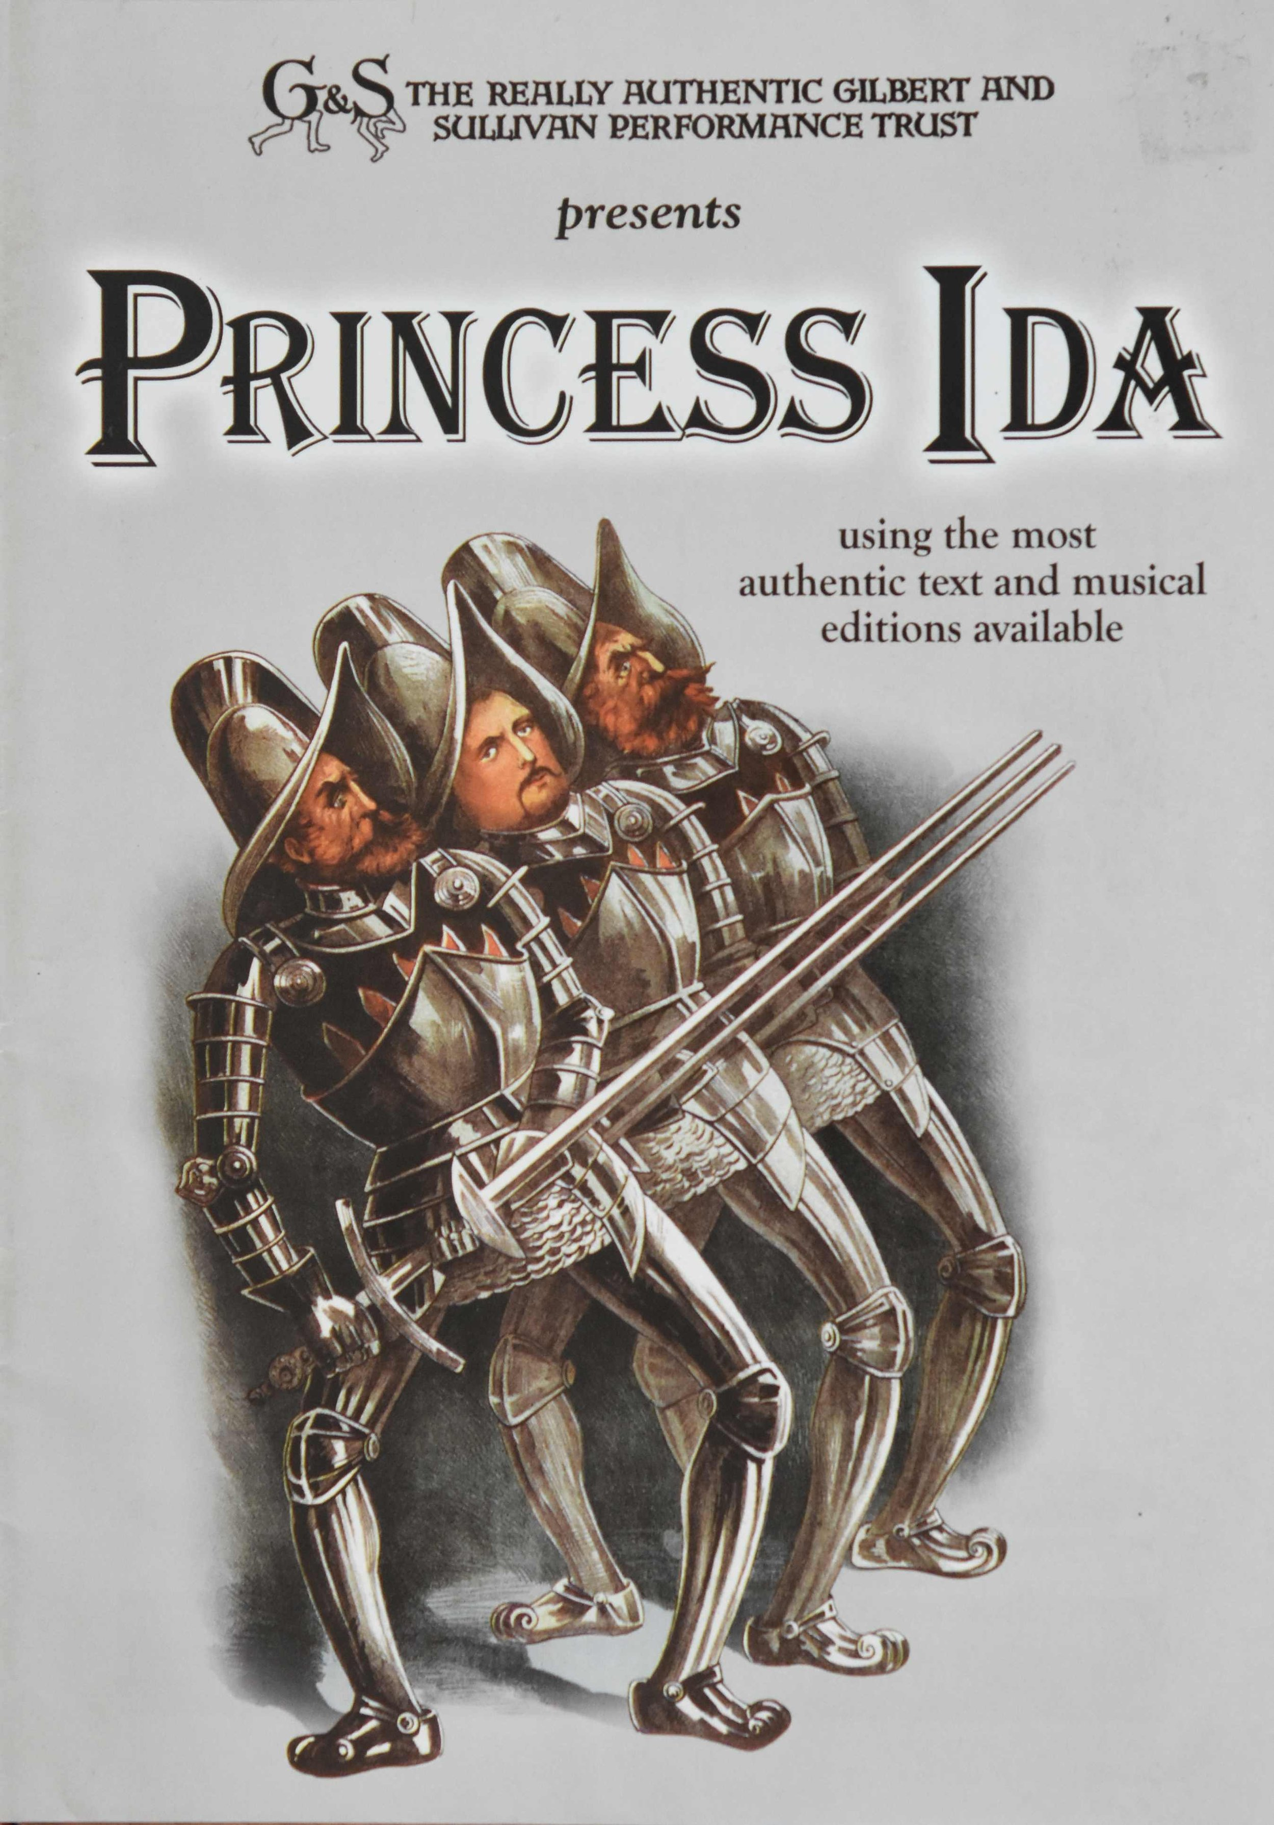
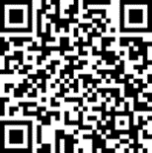

The Bentley
Charity no. 513983
presents
Gilbert & Sullivan’s
Princess
presents
Ida
or Castle
Adamant
5 February 2027
St Mary’s Church, Leathers Lane
Halewood L26 9TS
7.30 pm
6 February 2027
All Hallows Church Hall Greenhill Rd L18 6JJ
7.30 pm
7 February 2027
tickets
All Hallows Church Hall Greenhill Rd L18 6JJ
£12
2.30 pm
ticketsource.com/bentley-operatic-society
or phone: 07503 334376
or phone 07503 334376

